Slide 1








SpaceX Capstone
Jiawei Sui
7/17/2023

Slide 2



OUTLINE
Executive Summary
Introduction
Methodology
Results
Conclusion
Appendix

Slide 3

EXECUTIVE SUMMARY
Methodology Summary
Data Collection
Data Wrangling
Exploratory Data Analysis with SQL and Visualization
Interactive Visual Analysis with Folium
Machine Learning Prediction
Result Summary
Exploratory Data Analysis Results
Interactive Analysis Screenshots
Predictive Analysis Results

Slide 4

INTRODUCTION
By ingeniously reusing the first stage of its Falcon 9 rocket, SpaceX has been able to significantly reduce launch costs compared to traditional providers. While other companies face expenditures of over $165 million per launch, SpaceX's innovative approach brings the price down to a relatively affordable $62 million. This game-changing cost advantage positions SpaceX as a disruptive force in the industry, democratizing access to space for both governmental and commercial entities. With its bold vision and unwavering determination, SpaceX continues to push the boundaries of space exploration and redefine what is achievable.

Slide 5
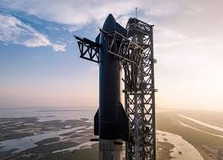
METHODOLOGY
Collect Data using Space X REST API and web scraping technologies.
Data Wrangling by filtering the data, handling missing values, preparing the data for exploratory data analysis and machine learning.
Exploratory Data Analysis using visualization and SQL
Interactive visualization analysis using Folium and Plotly Dash
Predictive analysis using various classification and regression models

Slide 6
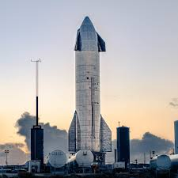
Data Collection
Request Data from SpaceX API
Using .json() and .json_normaliza() to preprocess the data and turn it to a pandas dataframe
Examine the missing values and replace them with the mean value or just drop them
Using the BeautifulSoup to scrape data for Falcon 9 launch records from Wikipedia

Slide 7
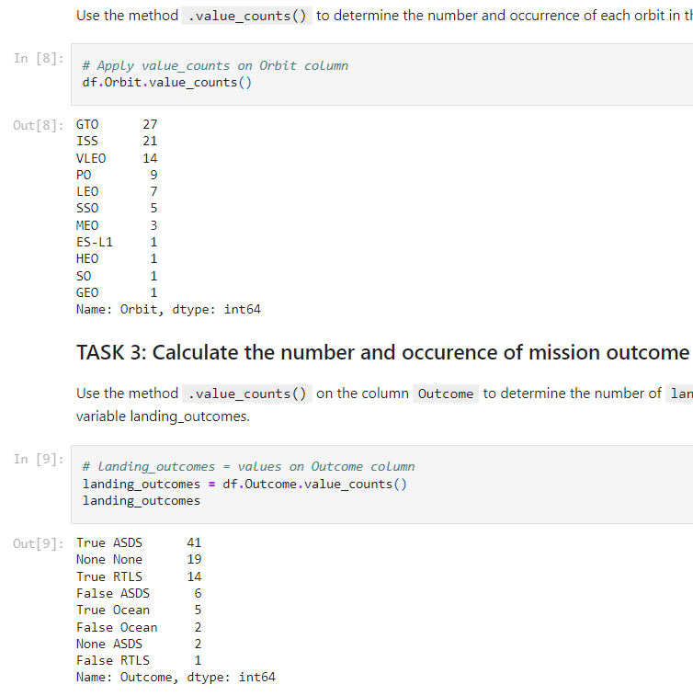
Data Wrangling
We calculated the number of launches on each site
We calculated the number and occurrence of each orbit
We calculated the number and occurrence of mission outcome per orbit type
We created a landing outcome label from Outcome column

Slide 8
Result Summary
Exploratory Data Analysis results
Interactive analysis screenshots
Predictive analysis results

Slide 9
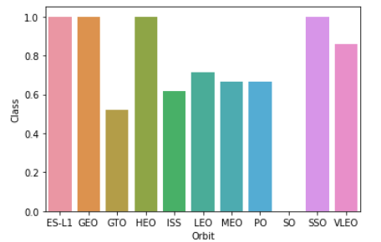
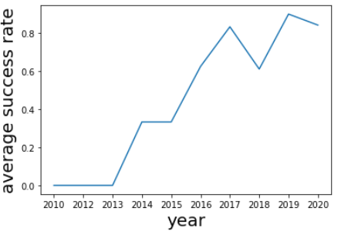
EDA with Data Visualization
Charts
Flight Number vs. Payload
Flight Number vs. Launch Site
Payload Mass (kg) vs. Launch Site
Payload Mass (kg) vs. Orbit Type
We explored the relationship among several variables using scatter plots, bar charts, and line plots

Slide 10
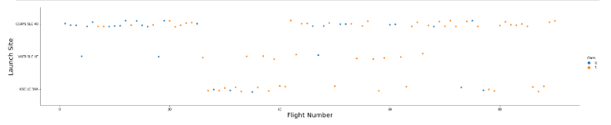
Flight Number and Launch Site
We use the function catplot to plot flight number and launch site, set the parameter x to flight number, set the parameter y to launch site, and set the parameter hue to class

Slide 11
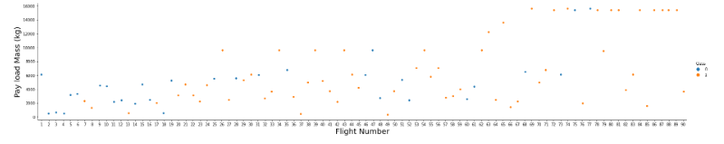
Flight Number and Payload Mass
We can plot out the flight number and payload mass and overlay the outcome of the launch. We see that as the flight number increases, the first stage is more likely to land successfully. The payload mass is also important. It seems the more massive the payload, the less likely the first stage will return.

Slide 12
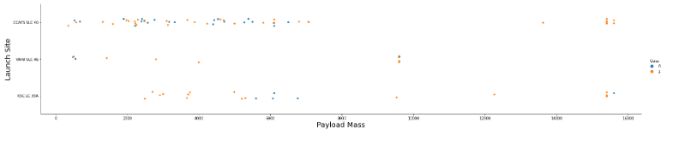
Payload and Orbit Type
We use the function catplot to plot flight number and launch site, set the parameter x to flight number, set the parameter y to launch site, and set the parameter hue to class

Slide 13
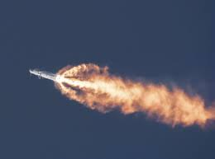
EDA with SQL
Charts
Flight Number vs. Payload
Flight Number vs. Launch Site
Payload Mass (kg) vs. Launch Site
Payload Mass (kg) vs. Orbit Type
We explored the relationship among several variables using scatter plots, bar charts, and line plots

Slide 14
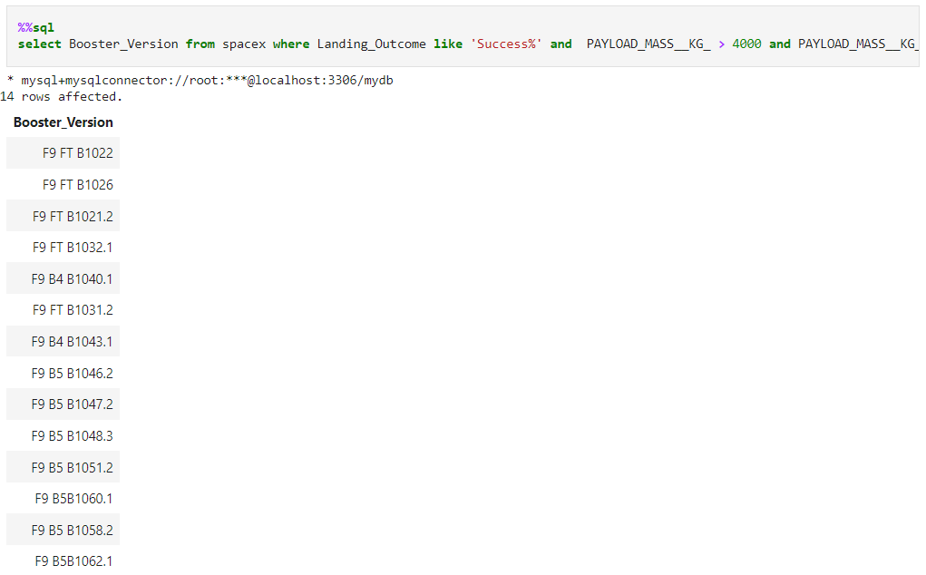
SQL Screenshots
Total Number of Successful Outcomes
We use where and like functions to generate a column of successful launch outcomes and use % function to minimize the search scope

Slide 15
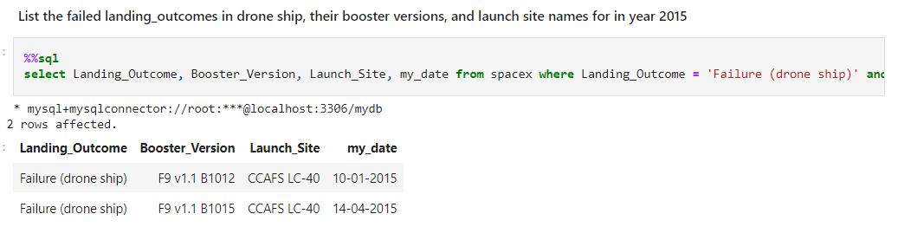
SQL Screenshots
We list the number of failed landing_outcomes in drone ship, their booster versions and launch sites names for in year 2015

Slide 16
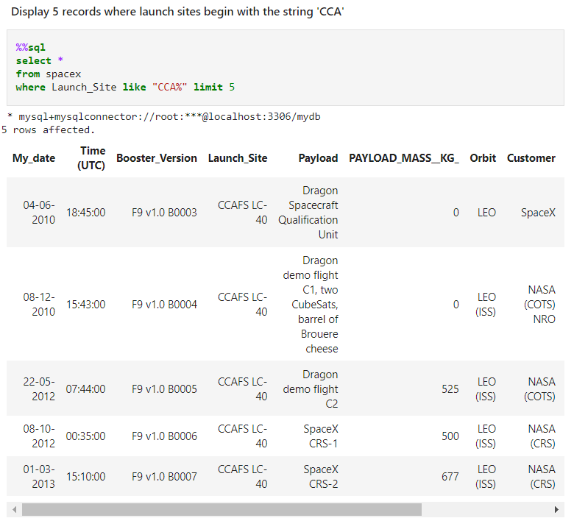
SQL Screenshots
Display 5 records where launch sites begin with the string “CCA”

Slide 17
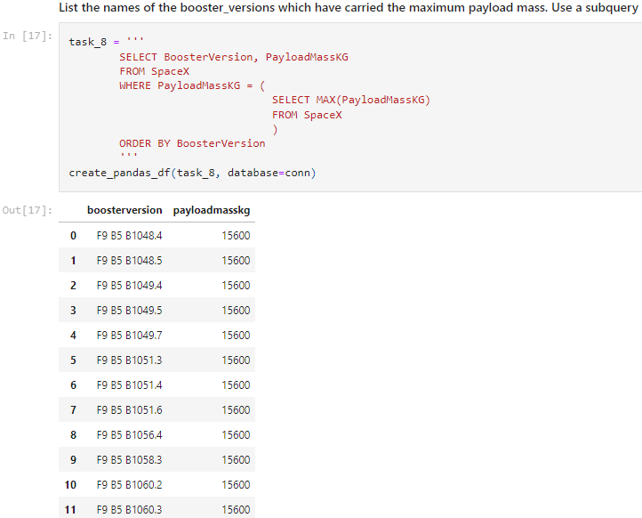
SQL Screenshots
We determined the maximum payload using a subquery in the WHERE clause and the MAX() function.

Slide 18
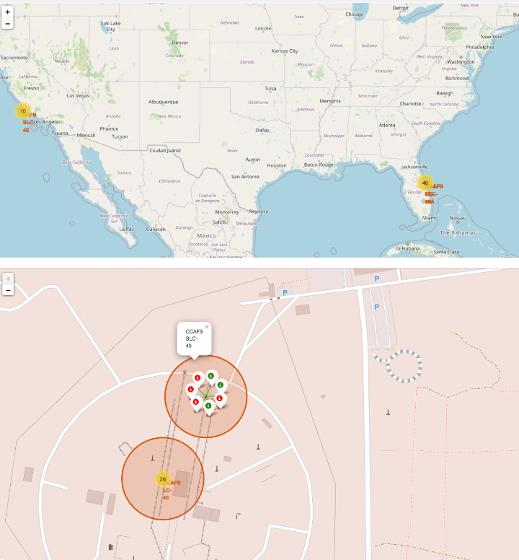
Interactive map with Folium
We use red markers to indicate launch sites in the United States and show its name using its latitude and longitude coordinates.
We use green to indicate a successful launch and use red to indicate a unsuccessful launch
The distances from a launch site to its proximities, railway, high way ,and coasts are explained in map.

Slide 19
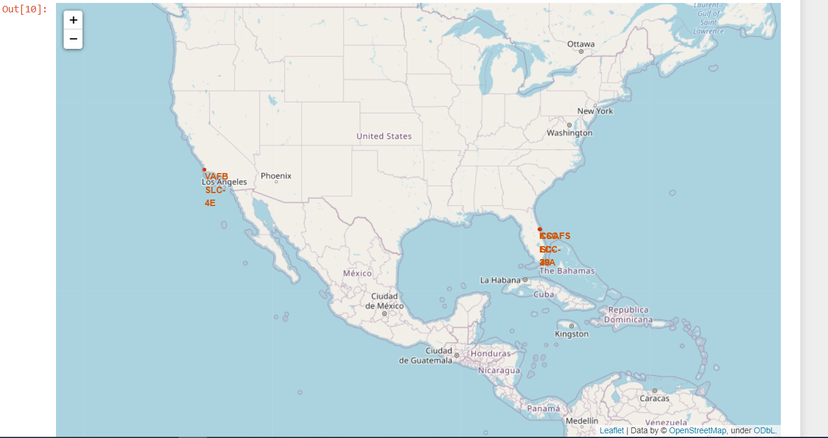
All launch sites on the map

Slide 20
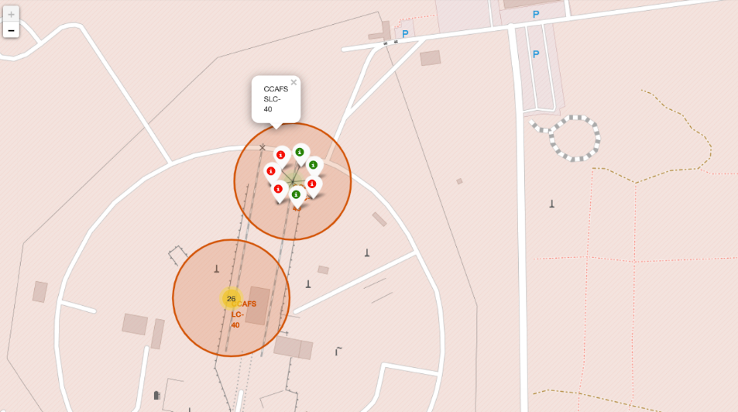
All successful and failed launches

Slide 21
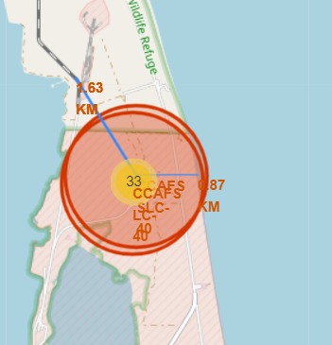
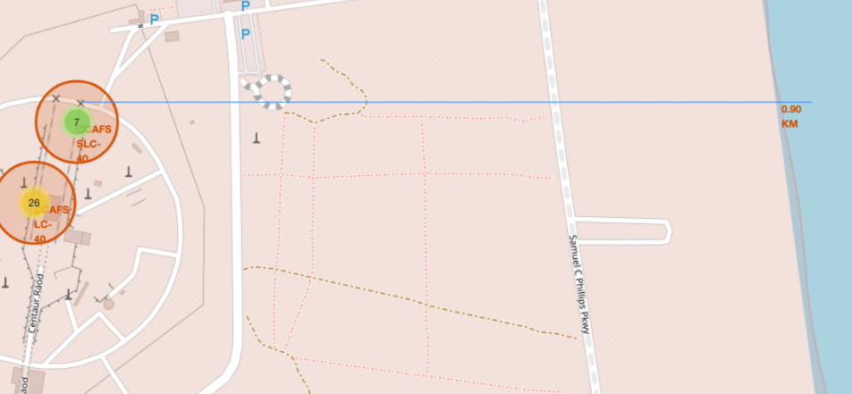
Distance to Proximities
AFS-LC-4
AFS-SLC-40

Slide 22
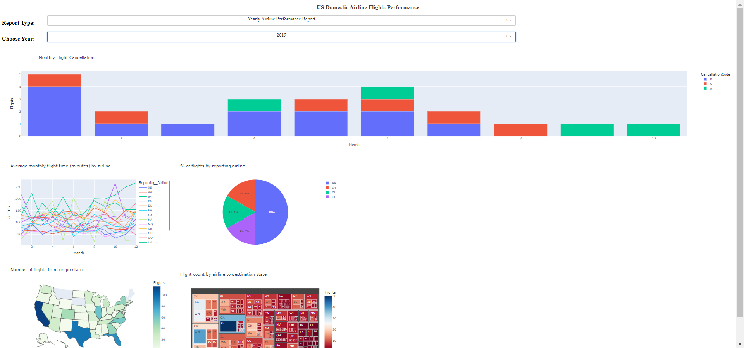
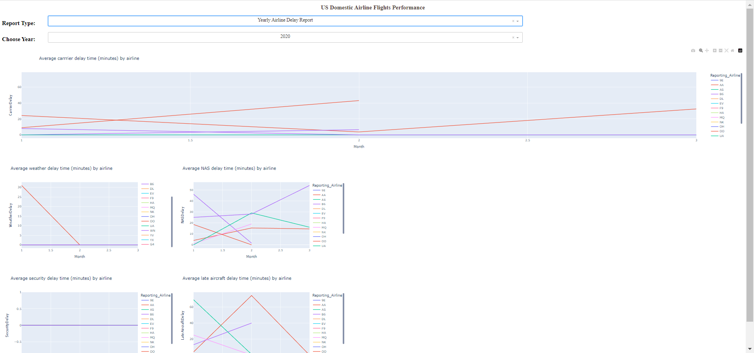
Dashboard with Plotly Dash
Dropdown list with launch sites allows user to select all launch sites
Pie charts show successful launches
Plotly Dash application for users to perform interactive visual analytics on SpaceX launch data in real-time.

Slide 23
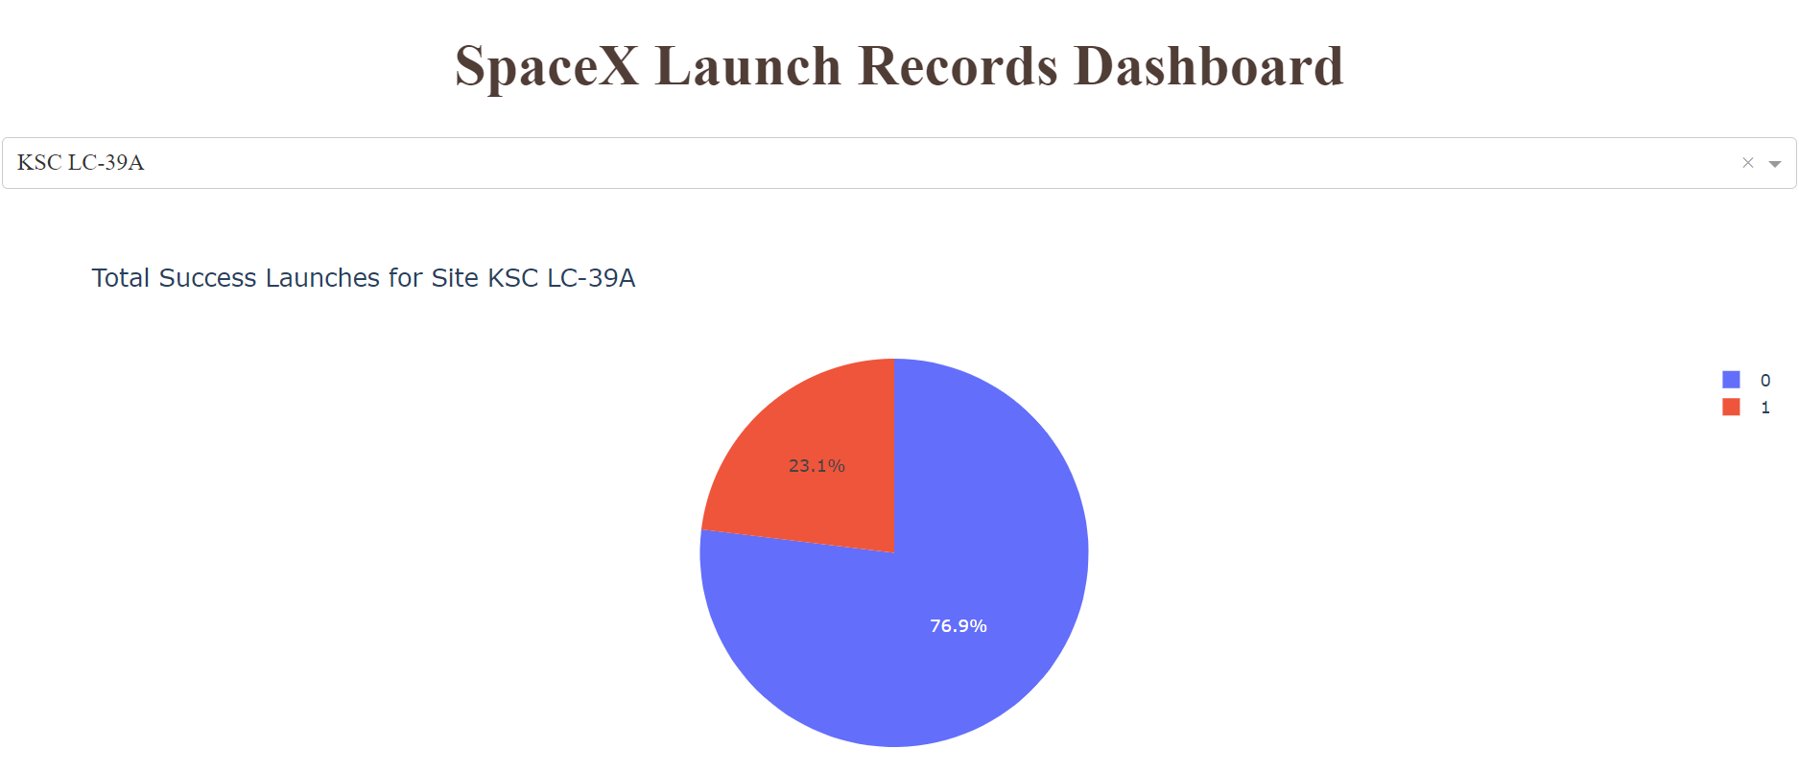
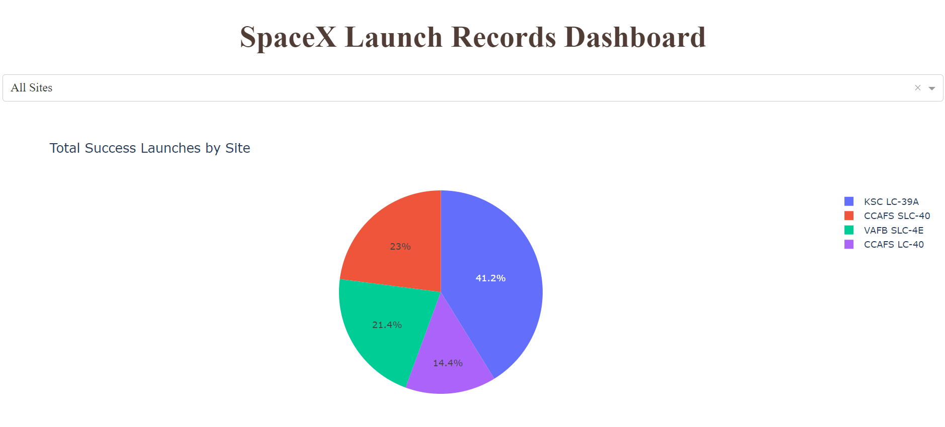
Launch Success
KSC LC-39A has the highest success rate among launch site
Total Success Launches by Sites

Slide 24
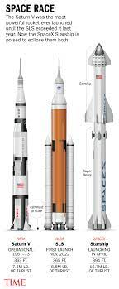
Predictive Analytics
The data was loaded, transformed, and split into training and testing sets for machine learning modeling.
Multiple algorithms were tried, including logistic regression, support vector machines, decision trees, and K-nearest neighbors.
Hyperparameter tuning was performed using GridSearchCV to improve the models' performance.
The best performing classification model was identified based on accuracy as the evaluation metric.
The predictive analysis involved importing packages, defining input and output data, and utilizing various algorithms to determine the best prediction results.

Slide 25
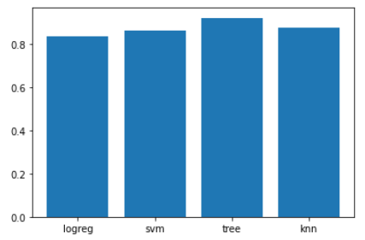
Classification Accuracy
We compared the accuracy score of each model, such as logistic regression, support vector regression, K Nearest Neighbors, and Decision Tree. It can be shown that the Decision Tree has the best accuracy with a score of 93%

Slide 26
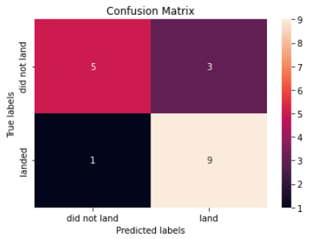
Confusion Matrix
Examining the confusion matrix, we see that Decision Tree regression can distinguish between the different classes. We see that the major problem is false negatives, aka unsuccessful landing marked as successful landing by the classifier.

Slide 27
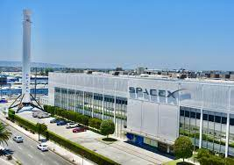
Conclusions
The success rate of launches at a site tends to increase as the number of flights conducted at that site increases.
From 2013 to 2020, there was a notable upward trend in the launch success rate.
Orbits such as ES-L1, GEO, HEO, and SSO exhibited the highest success rates.
Among all launch sites, KSC LC-39A stood out with the highest number of successful launches.

Slide 28
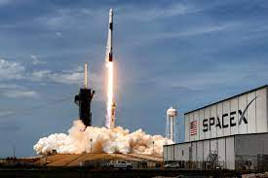
Conclusions
The Decision Tree classifier emerged as the most effective machine learning algorithm for this task.
The models performed comparably on the test set, with the decision tree model slightly outperforming others.
Launch sites are strategically located near the equator to benefit from the natural boost provided by the Earth's rotational speed.

Slide 29
Conclusions
All the launch sites are situated in close proximity to coastlines.
Launch success rates have shown a consistent improvement over time.
Payload mass has a positive correlation with launch success across all launch sites.

Slide 30


